Slide 1
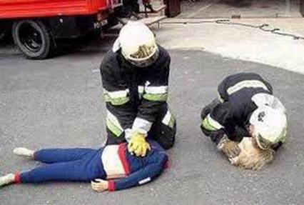
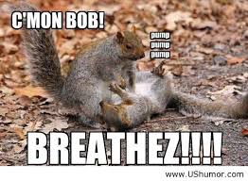
Airway/Respiratory Assessment
Lucy Vermeulen, 2013

Slide 2
NENA Core Competencies: Airway
“Assessment, intervention and monitoring is a
competency required by all emergency nurses”
Knowledge of airway anatomy and emergencies
specific to the adult/pediatric/geriatric populations
Assessment of airway to determine airway patency
Insertion of nasopharyngeal and oropharyngeal
airways
Suctioning of the airway
Utilization of non-invasive positioning to clear and
open the airway, including head tilt chin lift or
jaw thrust
NENA, 2014

Slide 3
Core Competencies, cont.
Perform and/or assist with insertion and maintenance of supraglottic airways
Perform and/or assist with intubation, ensure correct placement of ET Tube and monitoring of the intubated patient including EtCO2 monitoring
Assist with emergency cricothyrotomy and/or emergency tracheostomy
NENA, 2014

Slide 4
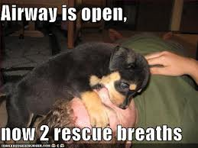
Airway
Always, a main priority in patient care

Slide 5
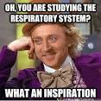
Anatomy Review
Respiratory System

Slide 6
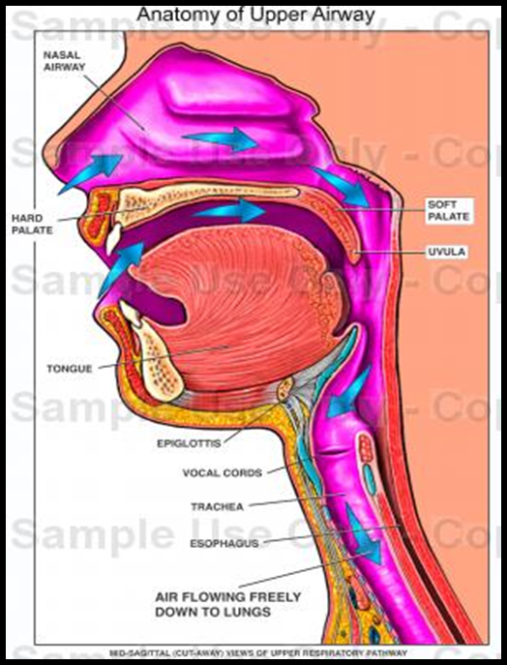
Upper Airway
Upper airway structures include the entrance (mouth, nose) to trachea.
The larynx is most heavily
innervated by vagus nerve. Stimulation can cause bradycardia in children. It can also cause spasm.

Slide 7
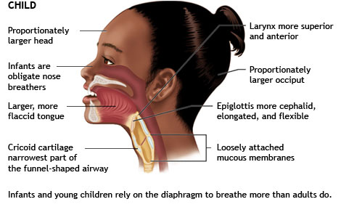
Airway of Child
Notes:
Larger tongue
Smaller pharynx
Larger epiglottis: good & bad
Trachea more narrow and less rigid

Slide 8
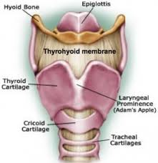
Airway Anatomy
The cricoid is smaller in
the female.
Cricoid pressure during intubation is thought to dec. risk of aspiration.
The cricoid may also be used for emergency airway.
Notes:
AKA Sellinik maneuver
Used to occlude the esophagus
Helps reduce inflation of the stomach during positive pressure ventilation

Slide 9
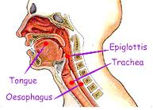
Epiglottis
Small flap of tissue at the base of the tongue.
Covers the larynx during swallowing, preventing
aspiration.
Any condition that alters one’s mental status or
swallowing ability can hinder the function of the
epiglottis and place one at increased risk for
aspiration (i.e CVA, dec. LOC)
(Lewis, Heitkemper & Dirksen, 2000)
Notes:
Lewis, S., Heitkemper, M., & Kirksen, S. (2000) Medical Surgical Nursing: Assessment and Management of Clinical Problems (5th ed.)
Missouri: Mosby.

Slide 10
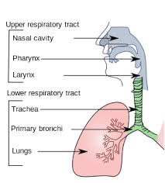
Lower Airway
The lower airway include
the trachea, bronchi,
lungs, alveoli and vascular
components.
The alveoli and pulmonary
capillaries are responsible
for gas exchange.
(ENA, 2007)

Slide 11
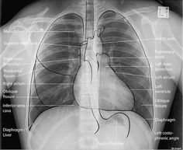
Airway Assessment
Respiratory System

Slide 12
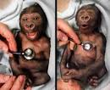
Airway Assessment
Look - pt. position, obstruction, secretions,
distress, colour, edema, tracheal tug
Listen - Vocalization, crying, adventitious
sounds, air exchange
Feel – palpation, tenderness, swelling, crepitus

Slide 13
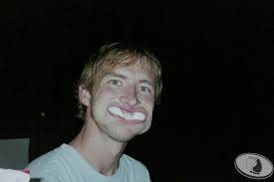
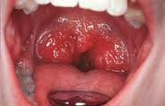
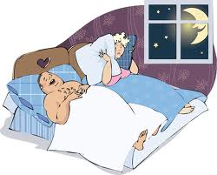
Compromise to airway patency
A noisy airway is an obstructed airway
Often caused by the tongue, foreign bodies, epiglottis- inflammation/infection/edema
Notes:
Is air not moving because of obstruction? Obstructions don’t necessarily mean noise
With increased obesity rates, we’re seeing increased sleep apnea. In these cases, some think that increased pharyngeal tissue contributes to the obstruction (Benumof, 2002) (Obstructive sleep apnea in the adult obese patient: implications for airway management, Anaesthesiology Clinics of North America, 20, 789-811)
Foreign body airway obstruction
Heimlich maneuver
Back blows chest thrusts
magills

Slide 14
Choking in Children
In the U.S, there are more than 17,000 annual ED visits of children and infants related to choking incidents; 80% of these visits involve children aged 4 or younger
(HealthLine, 2013)
Notes:
HealthLine, Connect to Better Health (2013). Choking. Retrieved Jan 10, 2013 from http://www.healthline.com/galecontent/choking-1

Slide 15
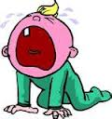
Breathing Noises
Noises: Indicative of compromise
Stridor: rapid airflow through narrowed airway;
High pitched
Inspiratory Stridor: supraglottic or glottic problem,
such as epiglottis; muffled cry; weak or hoarse voice
Expiratory Stridor: subglottic areas; normal voice,
brassy cough (Malchak, n.d.)
The baby who is not
crying is often in trouble here!

Slide 16
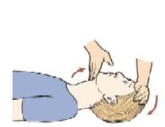
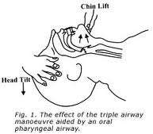
Open the Airway
Head tilt / chin lift
Not an option with
patients in C-spine
precautions
Notes:
Head tilt/chin lift
Place the edge of one hand on the victims forehead, begin to tilt the head back
At the same time place two fingers of the other hand under the chin and lift upward, tilting the head back
this maneuver pulls the base of the tongue away from the
Jaw Thrust
Maintains the neutral position of the cervical spine
Place your hands on the patients face
Grasp the mandible of the jaw with your fingertips and lift the jaw forward
So….with patients with suspected cervical spine injuries, which manoeuvre should we use?

Slide 17
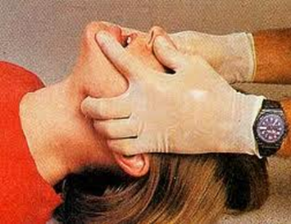
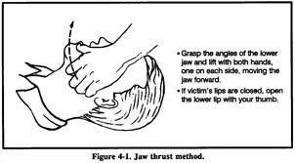
Open the Airway
Jaw Thrust
www.youtube.com/watch?v=r3ckgEQEE_o

Slide 18
In the child….
Because of the position of the
larynx in the child, hyperextension of the neck may actually worsen obstruction.
Place in sniffing position by
placing rolled towel under infant’s shoulders
(American Heart Association [AHA], 2007 )
Notes:
Bailey, P. (2013) Up to date: Basic airway management in children. Retrieved January 10, 2013 from http://www.uptodate.com/contents/basic-airway-management-in-children

Slide 19
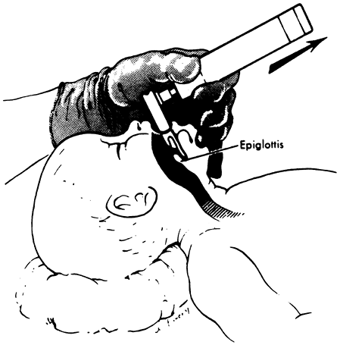
Sniffing Position

Slide 20
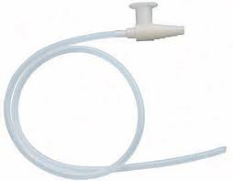
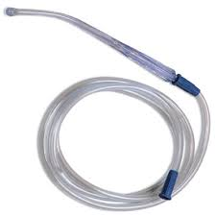
Promoting Airway Patency
Suction
Must be done gently to prevent stimulation of gag reflex and subsequent vomiting or aspiration.
Only done if person cannot cough effectively.
With infants, suction mouth first: this minimizes aspiration if infant gasps (AHA, 2006)

Slide 21
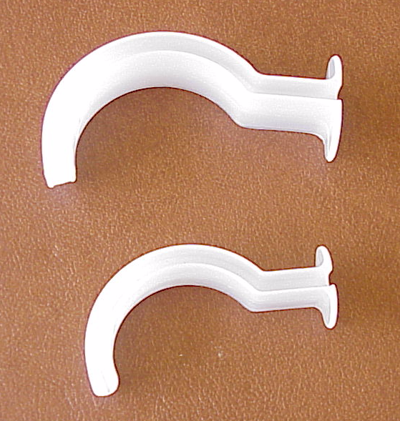
Airway Adjuncts: Oral
Orolaryngeal airway:
S shaped devices that hold the tongue away from the posterior wall of the pharynx
semiconscious \ unconscious patients
No cough or gag
help keep airway open with BVM
help suction the mouth
Notes:
Corner of the mouth to the tip of earl lobe or angle of the jaw

Slide 22

Sizing:
Flange at the level of the teeth and tip should end at the angle of the jaw
Measure from the corner of the mouth to the corner of the ear.
Adult range from 80 to 100mm

Slide 23
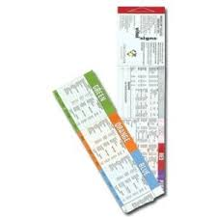
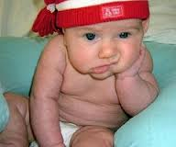
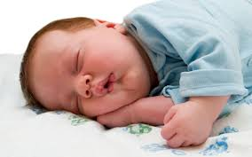
Pediatrics
Refer to Broselow tape to determine airway size
of children

Slide 24
Insertion of Oral Airway
Place the airway backwards as it enters the mouth, as the airway passes through the oral cavity and approaches the posterior wall of the pharynx, rotate the airway 180 degrees into proper position
PAEDS: Use tongue blade to displace tongue forward, and insert the airway curve down over the tongue

Slide 25
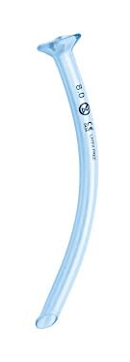
Airway Adjuncts: Nasopharyngeal
Uncuffed tubes made of soft rubber or plastic
Frequently used with semiconscious or intoxicated pts. who refuse oral airway
Use with patients with strong gag, massive mouth trauma, wired jaws
Avoid in patients with neuro injuries

Slide 26
Sizing for Nasopharyngeal Airway
Select diameter slightly smaller than the nare
The length should be equal to the distance from the nares to the tragus of the ear (earlobe)
Measure from the tip of the nose to the corner of the ear
Insert bevel toward the septum
Adult sizes range from 6 to 9 mm
For pediatrics, check the Broselow tape
Notes:
Corner of the mouth to the tip of the earlobe or angle of the jaw

Slide 27
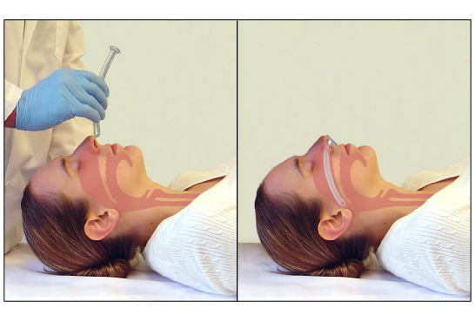
Insertion
Notes:
Bailey, 2013

Slide 28
Insertion:
Lubricate with water soluble lubricant or anesthetic gel
Gentle insert close to the midline along the floor of the nostril
Continue inserting the airway into the posterior pharynx behind the tongue
If resistance is encountered rotate slightly

Slide 29
Remember
Failure to manage the airway is the leading cause of preventable deaths in children (Malchak, n.d.).
It’s always airway, airway, airway first!

Slide 30

Assess Breathing
Respiratory System

Slide 31
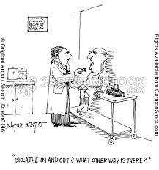
Breathing Assessment
So the airway is patent….is he/she breathing?

Slide 32
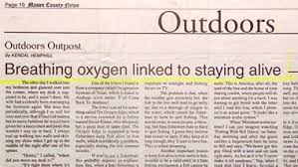
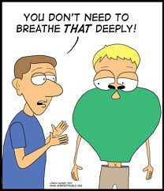
Breathing
Breathing is important too!
Dec. 2013

Slide 33
NENA Core Competencies: Breathing
“Assessment, intervention and monitoring of
respiratory status is a competency required by all
emergency nurses”
Knowledge of respiratory anatomy and emergencies
specific to the adult/pediatric/geriatric populations
(e.g. asthma, croup, bronchiolitis, epiglottitis, COPD,
pulmonary edema, pulmonary embolus)
Assessment of effective versus ineffective ventilations
Chest auscultation and identification of normal and
abnormal breath sounds
NENA, 2014

Slide 34
Core Competencies cont.
Knowing when to administer oxygen, the amount and by the appropriate means
Using a bag-valve mask device
Perform and/or assist with arterial/venous/capillary blood sampling
Interpretation of blood gas results
Assist with setting up, insertion of chest tubes, and monitoring chest tube drainage
Interpretation and monitoring of oxygen saturation
Collection of peak flow measurements
NENA, 2014

Slide 35
Core Competencies cont.
Identification of life threatening respiratory conditions and perform and/or assist with appropriate interventions
Care of CPAP and ventilated patient in the emergency department
NENA, 2014

Slide 36
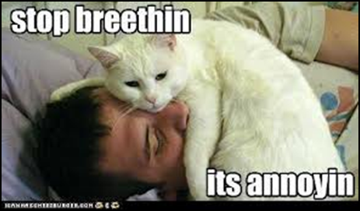
Someone disagrees!

Slide 37
Assess
Rate
Rhythm
Depth
Quality
Breath sounds
Chest expansion
Effort
Vital signs
Notes:
Normals
Adults 12-20/min
Children 15-30/min
Infant 25-50/min
Tachypnea increased rate
Bradypnea slow but regular
Assess the pt.’s ability to move air
Look, listen, feel
Spontaneous breathing
Establish breathlessness
Are respirations absent or inadequate?

Slide 38
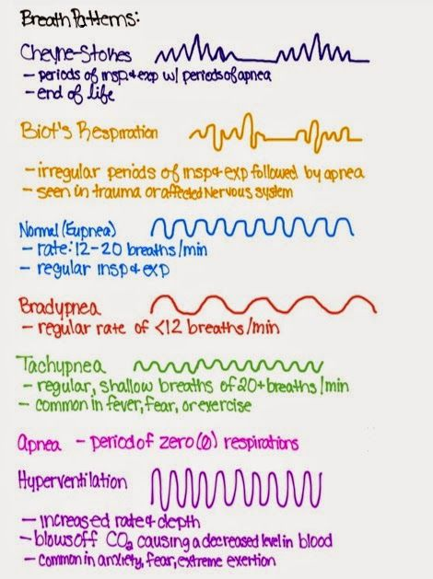
Notes:
What kinds of things affect rhythm?
Kussmaul’s respirations: fast & deep respirations without pause. Causes include: renal failure, metabolic acidosis, DKA
Cheyne-Stokes: faster and deeper then slower, alternating with apneic periods. Causes: increased ICP, cardiac & renal failure, OD

Slide 39
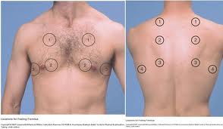
Quality - Auscultate
Presence of breath sounds
Audible throughout
Compare
side to side
Listen to front
and/or back
Ensure auscultation
is done directly on skin
Notes:
Crackles, wheezes, rubs, stridor (review if necessary-included at Central)

Slide 40
Breath Sounds
http://www.youtube.com/watch?v=0Q6J0ybSuNo
http://www.youtube.com/watch?v=5JA6D1Mguh0

Slide 41
Quality – Chest expansion
Rise and fall of chest
? Symmetrical
? In-drawing
Use of accessory muscles

Slide 42
Quality- Effort
Assess work of breathing
Grunting
Positioning i.e. sitting, leaning forward
Tracheal Tug
Nasal Flaring

Slide 43
Signs of Respiratory Compromise
Snoring respirations
Stridor
Retractions
Accessory muscle use
Rapid shallow resp.
Cyanosis
Panic look
Dec. oxygen saturation, altered resp. rate
Time for INTERVENTIONS
https://www.youtube.com/watch?v=Hv68EQ3tCBI

Slide 44
Respiratory Efforts
https://www.youtube.com/watch?v=vvgTCG18oZo
https://www.youtube.com/watch?v=TqlzHJbxCV0
https://www.youtube.com/watch?v=LJVfErMKRi8
https://www.youtube.com/watch?v=Hv68EQ3tCBI

Slide 45
Oxygen delivery
Frequently patients are simply not breathing well enough and require oxygen
This can be done passively or by using positive pressure
Ex: nasal prongs
CPAP, Bipap,
mechanical ventilation

Slide 46
How Much O2 Can I Give?
In most adults, keep oxygen saturation greater than 92%
For CO2 retainers, usual desired SpO2 is 88-92%
For newborns requiring resuscitation, start with room air
using positive pressure.
Newborns have oxygen sats 60% in utero. This must be
gradually increased to target sat of 90% but only after 10 min.
Too much oxygen can lead to injury in the newborn/premie.
Always check the target ranges (located in the pediatric
resuscitation area: Panda).
For most pediatric patients: >95%
Notes:
For patients with ACS – oxygen is now indicated only if SpO2<94%

Slide 47
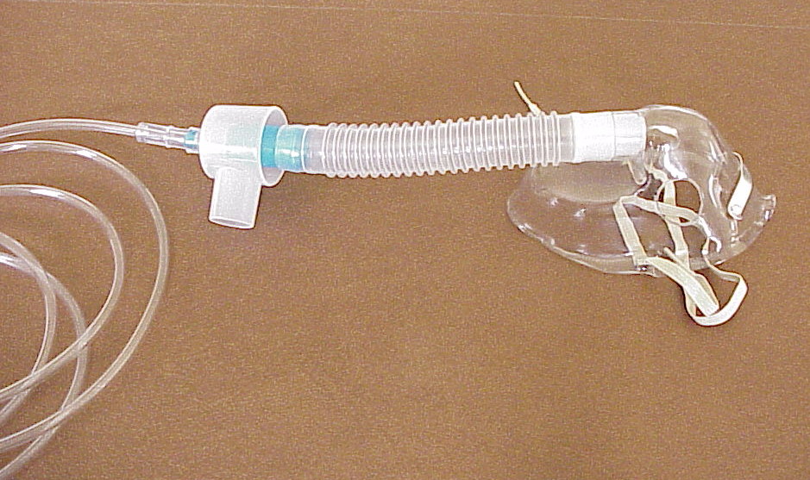
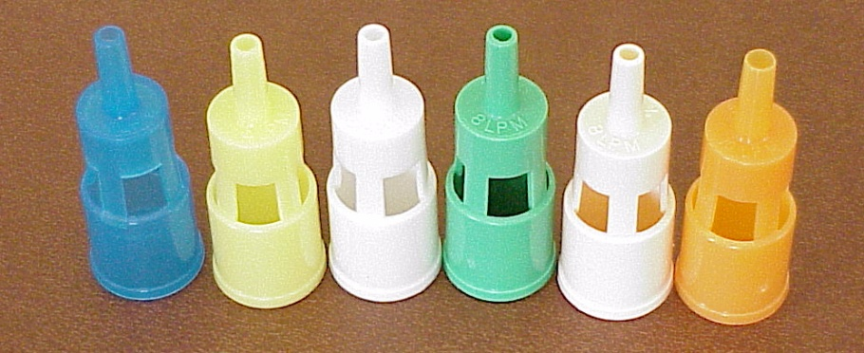
Venturi mask
Notes:
Covered in CNO

Slide 48
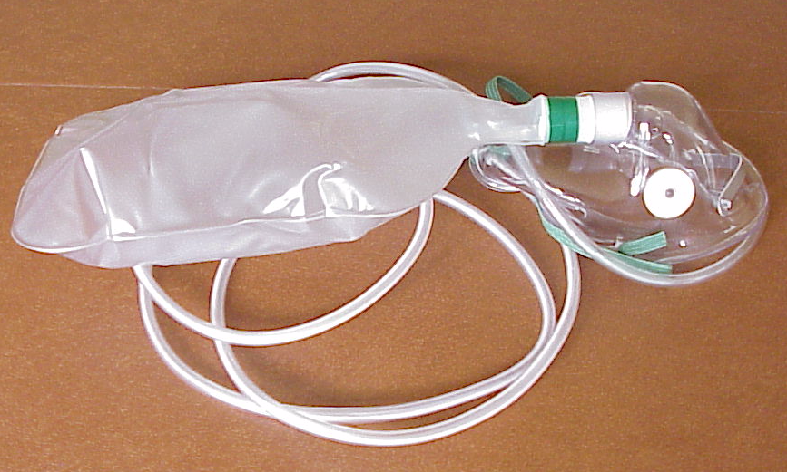
Non rebreather O2 mask

Slide 49
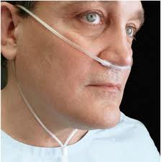
Nasal Prongs

Slide 50
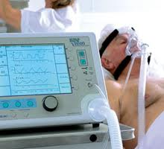
Noninvasive Positive Ventilation: BIPAP
Two levels of positive pressure. The inspiratory level is variably positive, and is always higher than the expiratory pressure.
The unit is intended to be used with an FI02 of 21%, but oxygen can be supplemented. Generally, oxygen flow rates of 1-2 l are sufficient to maintain an adequate oxygen saturation
Set up by RT
Managed by RN

Slide 51
Bipap
https://www.youtube.com/watch?v=lfpytAl75E8
Notes:
Provide two levels of pressure,
IPAP: this is the pressure applied during patient triggered breaths.
EPAP: this is the pressure applied in between patient triggered breaths. It could also be considered a continuous positive pressure.
FiO₂: The fraction of O₂ percentage that is being added to the delivered air.

Slide 52
Indications for BIPAP
CHF exacerbation
COPD exacerbation
Pneumonia
Status asthmaticus
Droplet/Contact Precautions
Notes:
Acute Care:
􀂄 impending respiratory failure (not requiring intubation)
􀂄acute respiratory acidosis
􀂄 respiratory distress
􀂄 use of accessory muscles or paradoxical breathing
􀂄 Congestive heart failure :increases intra thoracic pressure (augments performance of left ventricle, decreases venous return which in turn decreases right ventricular preload);
prevents worsening pulmonary edema, increases oxygenation, prevents atelectasis. Decreases work of breathing
Re-directs fluid away from pulmonary/cardiac vasculature

Slide 53
Bipap Considerations
Increased potential of aspiration
lack of airway protection
full stomach
hiatus hernia, may require an NG or an OG tube
patient should not be laid flat to prevent
regurgitation (recommend keeping the head of the
bed at a 45 degree angle)
caution with sedation
restraints
LHSC, 2010

Slide 54
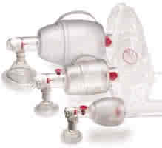
Bag Valve Mask
Consists of self filling bag, and a valve (non- rebreathing)
Attenuates the urgency to intubate
the first intervention for inadequate oxygenation and ventilation (once airway patency determined)
Size: adult, pediatric, neonate

Slide 55
Bag Valve Mask
Tight seal
Covering both mouth and nose
Slow gentle ventilation to minimize risk of gastric inflation
Practiced skill
Supplemental oxygen
Notes:
adult and paeds size

Slide 56
BVM
Use the correct size for the patient
Place the top of the mask over the bridge of the patients nose then lower the mask over the mouth and upper chin
Squeeze the bag once every 5 seconds (adult), every 3 seconds (Paeds)
Release pressure and let pt exhale passively

Slide 57
Definitive Airway
For resuscitation patients, a definitive airway is frequently
indicated.
Ex. decreased LOC, anticipated airway
compromise/obstruction, anticipated muscle paralysis,
expected delivery of extended positive pressure
ventilation
When this is completed in the community, EMS would consider an endotracheal tube. When that is too difficult to
insert, they may consider a laryngeal mask airway, King
combo, or Combitube.

Slide 58
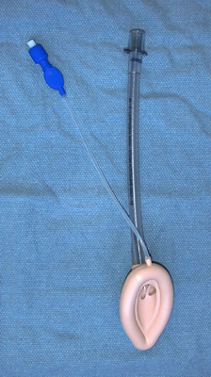
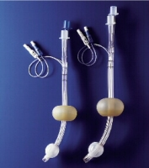
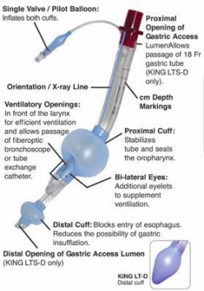
Advanced Airways
LMA
Combitube
King

Slide 59
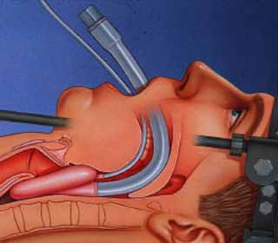
LMA- laryngeal mask airway

Slide 60
LMA Insertion Video
http://www.youtube.com/watch?v=96e46PyARaU
LMAs found in difficult airway cart
At UH: Pediatric LMAs found in Resus 3 bedside cart

Slide 61
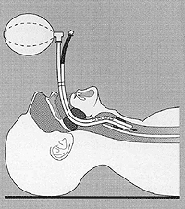
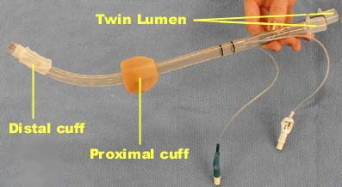
Combitube
Notes:
Contraindications: Responsive patients with an intact gag reflex.
Patients with known esophageal disease.
Patients who have ingested caustic substances.
Known or suspected foreign body obstruction of the larynx or trachea.
Presence of a tracheotomy
Indications: Blind insertion; usually inserted in the esophagus. Both cuffs then need inflation.

Slide 62
Combitube Insertion Video
http://www.youtube.com/watch?v=Je418vwetZM

Slide 63
King Airway
Color indicates size
60 mL leur-lock syringe inflates both
balloons simultaneously
Cannot be used for people < 4 ft. in length

Slide 64
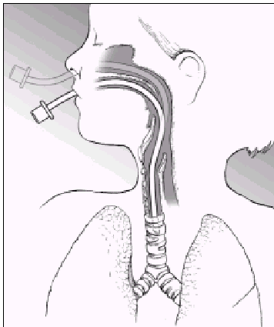
Intubation
Tracheal intubation
gold standard
enters the trachea
stops at carina
Notes:
ET tube – different sizes, cuffed vs uncuffed

Slide 65
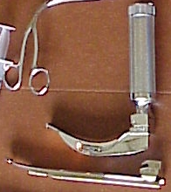
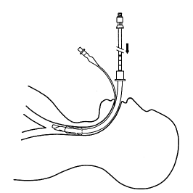
Checklist for Intubation
Monitor: ECG, Spo2, BP –continuous monitoring
Call RT; BVM(rate of 15 L\min)
Meds: for RSI (Rapid Sequence Intubation)
Suction ready
Check for dentures
IV access

Slide 66
Checklist
Check laryngoscope
Select Tube
ET:
Insert stylet into tracheal tube
Check balloon—check for leaks,
Oxygen connected
CO2 detector (end-tidal not used
in newborns)

Slide 67
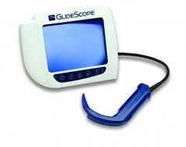

Equipment

Slide 68
MALLOTSS-acronym
M-Mask
A-Airway
L- Laryngoscope
L- Light
O- Oxygen
T- Tubes(ETT, NG)
S- Syringe
S- Stylet
S- Suction

Slide 69
Intubation Video
https://www.youtube.com/watch?v=10enx5T-2_8

Slide 70
Post-intubation
Complications
Esophageal intubation
Right main-stem intubation
Structural injury
Assess positioning
Listen over the stomach
Listen to both lung fields
Average depth of insertion: 20-22 cm women;
21-23 cm men (Document)

Slide 71
Post-intubation
Secure the tube
Inflate the cuff (if adult/older child)
Continue bagging or attach ventilator (RT)
CXR to confirm positioning
Ongoing vital signs/respiratory
assessment/ sedation monitoring

Slide 72

Ongoing monitoring
Respiratory System

Slide 73
End-tidal CO2 Monitoring
Now used as standard with
respiratory arrests/compromise/procedural sedation
ET CO2 is a reliable measurement
of cardiac output during CPR
Can be used as a tool in measuring
effectiveness of compressions
Values below 10mm Hg during CPR indicate a problem
Goal: 10-15
(Marx, Hockberger & Walls, 2006)

Slide 74


ET tube
T connector
Ambu bag
Gas sampling line
Notes:
Found in resuscitation rooms

Slide 75


Slide 76



Capnography
Confirms presence of CO2
Ongoing monitoring of CO2 levels

Slide 77
Blood Gases Analysis
Determine acid-base balance by evaluating the pH
pH = 7.4 balanced
pH 7.35 - 7.39 (normal range/compensated acidosis)
pH 7.41 - 7.45 (normal range/compensated alkalosis)
pH< 7.35 acidosis
pH > 7.45 alkalosis

Slide 78


Slide 79


Slide 80


Slide 81

Cricoidotomy/ Emergency Tracheostomy

Slide 82

Last Ditch Effort: Thoracotomy
Indications:
Penetrating trauma
Rapid exsanguination
from chest tube
Blunt thoracic injury with
unresponsive hypotension
(Brohi, 2001)

Slide 83




Common ED respiratory presentations

Slide 84
Anaphylaxis
“an acute, potentially life threatening,
hypersensitivity reaction”
may feel a sense of doom
Often several systems involved
Quick onset; may be followed by secondary event
Lockey, 2012
Notes:
Gastro-intestinal: Abdominal pain, hyperperistalsis with faecal urgency or incontinence, nausea, vomiting, diarrhea. Oral: Pruritus of lips, tongue and palate, edema of lips and tongue. Respiratory: Upper airway obstruction from angioedema of the tongue, oropharynx or larynx; bronchospasm, chest tightness, cough, wheezing; rhinitis, sneezing, congestion, rhinorrhea. Cutaneous: Diffuse erythema, flushing, urticaria, pruritus, angioedema. Cardiovascular: Faintness, hypotension, arrhythmias, hypovolemic shock, syncope, chest pain. Ocular: Periorbital edema, erythema, conjunctival erythema, tearing. Genito-urinary: Uterine cramps, urinary urgency or incontinence

Slide 85


Slide 86
Treatment
Epinephrine
Benadryl
Ranitidine
IV Steroids
Salbutamol
Monitor 4-6 hours
Epi-pen with teaching
Notes:
Epinephrine stimulates both the beta-and alpha-adrenergic receptors and inhibits further mediator release from mast cells and basophils
Benadryl/Ranitidine reduces both histamine-induced cardiac arrhythmias, which are mediated via H2 receptors, and anaphylaxis-associated vasodilation
Corticosteroids do not benefit acute anaphylaxis but may prevent relapse or protracted anaphylaxis

Slide 87

Epiglottitis
Bacterial infection causing inflammation and swelling of the epiglottis and surrounding tissues
Usually Haemophilus influenza type B
Sudden onset of symptoms: high fever, severe sore throat, difficulty swallowing, drooling
Notes:
S&S: drooling, leaning forward, unable to swallow saliva, fever, flushing, dyspnea, anxiety (EMA, 2005)

Slide 88
Epiglottitis Interventions
Directed at maintaining a patent airway!!
O2
IV antibiotics
Prepare for BMV ventilation and intubation
Have emergency trach supplies at bedside!
Sedation!
Notes:
Avoid upsetting child, because this may lead to larygospasm and subsequent airway obstruction. Avoid oral and rectal temperatures. Maintain NPO!
All children with epiglottitis will require admission to hospital. X-rays may be performed if the airway is stable, and if there is a question of the diagnosis. Radiographic antero-posterior and lateral views of the neck will show the degree of airway narrowing. This assists in determining the immediate management of the patient. Airway management equipment and the appropriate personnel should accompany the patient to radiology if the x-ray prior to intubation approach is taken. Portable soft tissue views more common.
Intubation in the OR is preferred.

Slide 89
Croup
Upper Airway inflammation
Barky cough, hoarseness, stridor
Hx. Cold symptoms
Possible Fever
Most frequent cause of upper
airway obstruction in children.
Not common in young infants
Notes:
more technically known at acute larynogotracheobronchitis.
Viral
Causes edema and inflammation of the larynx & tracheal mucosa.
Tx: humidified oxygen; corticosteroids to decrease swelling; nebulized racemic epinephrine (EMA, 2005)

Slide 90
RSV (Resp. Syncytial virus)
Common pediatric ED presentation
Most children have had this by age 2
Can be serious in infants or those
immunosuppressed****
Stuffy nose, cough, mild fever, sore throat
Notes:
Usually not serious; treat like URTI

Slide 91

COPD
Notes:
Emphysema: both ventilation and perfusion are decreased. Alveolar damage makes them prone to collapse on expiration, leading to air trapping. Pursed lip breathing and tripod positioning allows pt to keep PEEP which keeps airways open. This increases work of breathing contributing to SOB.
Bronchitis; airway obstruction leads to hypoxia and pulmonary vasoconstriction. High resistance in the pulmonary vasculature, dec. circulating blood volume and R CHF leads to polycythemia, hypoxia and cyanosis.

Slide 92
Reactive Airway Disease: Asthma
Chronic inflammatory disorder of the airways
Can be controlled not cured
50% onset before age 10
30% diagnosed in childhood will have it as an adult
Immunological and non-immunological triggers
Allergens, weather, exercise, GE reflux, colds & flu

Slide 93
Asthma exacerbation
Cough
Wheezing
Chest tightness
SOB, tachypnea
Unable to speak in full sentences
Labored breathing
Paeds nasal flaring use of accessory muscles, tracheal tug
Bronchospasm & Airway inflammation

Slide 94
Asthma & COPD Medical Directive VH-AED & UH
Adult (>14yrs)
Diagnosis of Asthma or COPD
Present with SOB & wheezes
Vs, O2sat, O2 delivery, Spirometry
Ventolin 6 puffs & atrovent 6 puffs
Or
Ventolin 5mg & atrovent 500mcg
RT or RN
May be repeated once
Notes:
Ventolin – broncodilator. Be careful: if patient is really tachycardic, ventolin may be contraindicated
Atrovent - this results in decreased contractility of smooth muscle in the lung, inhibiting bronchoconstriction & mucous scretion; contraindications are similar to other anticholinergics; they include narrow angle glaucoma and obstructions in the GI an GU system
READ: the directive before starting to use

Slide 95
Asthma/COPD Medical Directive Inclusion Criteria
Previous diagnosis of asthma/or chronic obstructive pulmonary disease (COPD)
Circumstances:
Shortness of breath is the reason for the emergency visit
Inspiratory and/or expiratory wheezes present or
the absence of wheezes (due to severe lack of air movement)
Procedures / treatments / interventions:
Vital signs including O2 saturation

Slide 96
***Ensure you’ve read the
learning package before
using
***Ensure you’ve
completed a respiratory
assessment
prior to beginning
directive
Document assessment.
Document initiation of
medical directive if
appropriate/indicated.
Document ongoing
reassessments and
response to treatment.
Vitals pre- and post-treatment

Slide 97
Medications: Ventolin
Beta 2 adrenergic agonist
that works as bronchodilator and increases
air flow.
Common side effects of the beta adrenergic
agonists include dizziness, headache, nervousness,
tachycardia, palpitations, nausea and
diaphoresis, largely due to their beta adrenergic
effects on other tissue.

Slide 98
So……
If a patient presents with acute SOB and
uncontrolled a. fib with a rate of 148, do
you initiate the medical directive and give Ventolin if this patient has a COPD history?

Slide 99
Atrovent/Ipratropium
An anticholinergic that inhibits the actions of
acetylcholine at parasympathetic receptor sites
in the bronchial smooth muscles resulting in
bronchodilation. It also reduces the mucous
production.
Fast-acting but longer lasting than Ventolin.

Slide 100
Steroids
Solumedrol/Methyprednisolone or oral Prednisone:
helps treat inflammation.
Usually only given for a few days, although
many end-stage COPDers are steroid
dependent.

Slide 101
Scenario
You are taking over the care of a 28 yr. old
patient who is admitted with acute exacerbation
asthma triggered by URTI. She has a history of
Type 1 DM and her sugars are poorly controlled
despite adherence to treatment protocols.
She is on Solumedrol 125 mg q8hr along with
sliding scale insulin, ventolin and atrovent.
What can you expect?

Slide 102
Pneumonia
Viral, bacterial or fungal
Fever
Prod cough
Tachypnea, tachycardia
Chest/shoulder/abdominal pain
Vomiting in children
Diminished breath sounds over area often with crackles
CBC, CXR, sputum C&S, ABx, O2,humidity, PPE
Notes:
Levaquin

Slide 103


Slide 104
Pneumonia: Treatment
Precaution strategies
Possibility of sepsis: SIRS?
Oxygenation needs
Antibiotics

Slide 105
Pneumothorax/Hemothorax
Accumulation of blood or air in the pleural space…enters on inspiration
A tension pneumothorax causes an increase in intrathoracic pressure that pushes the heart, great vessels, trachea and esophagus towards the unaffected side…eventual collapse of both lungs

Slide 106
Pneumothorax/Hemothorax Signs & Symptoms
Male 20-40 yrs (tall, thin & twenty)
hx of chest wall trauma
Dyspnea, cyanosis
Chest pain on affected side
Decreased air entry
Subcutaneous emphysema
Tracheal shift
Tension pneumothorax: an emergency

Slide 107


Needle Thoracentesis
14 g over the shaft needle (angio)
2nd or 3rd intercostal space
Mid clavicular line
STAT relief
Will require chest tube
Notes:
Refer to Central chest tube presentation!!

Slide 108




Chest Tube

Slide 109
Chest drainage
Connection to wall suction
Do NOT clamp unless changing drainage
device (only momentarily)
Assess drainage (<200ml/hr)
Assess for air leaks
During transport, device is usually working by gravity and not portable suction

Slide 110
Pleurivac Drainage System Video
http://www.teleflex.com/en/usa/prod_a-6000.php

Slide 111
Pulmonary Embolism
A dislodged clot (blood, fat or air) that travels through the right side of heart lodging in a pulmonary vessel, obstructing blood flow and decreasing perfusion to a portion of the lung.
A leading cause of death
Notes:
3rd leading cause of death in the U.S. Approx. 400,000 cases go undiagnosed annually, leading to approx 100,000 deaths (EMA, 2005).

Slide 112


Slide 113
PE signs & symptoms
SOB
Tachypnea, tachycardia
Sudden onset of pleuritic chest pain that increases with respiration
Conditions: deep vein thrombosis, long bone #s, trauma to pelvis, post-op immobility, CHF, obesity, acute infections, scuba diving, childbirth, BCPs
Notes:
Vague symptoms making it difficult to diagnose
Most common: SOB, pleuritic chest pain, tachypnea, tachycardia, diaphoresis, anxiety,
most common in women than men
5x more common during pregnancy

Slide 114
Pulmonary Embolism
30% die within first 3 hrs.
60-80% of PE unrecognized clinically
60 000 episodes/yr in Canada
15 000 deaths/yr
If arrive to ED alive…tx aimed at supportive care, preventing 2* clot or preventing current clot from worsening (heparin)

Slide 115
Respiratory System: Nursing Assessment
Undress the patient
Do all vital signs
Full A…B…C…D assessment on ALL patients
Is airway patent
Is patient breathing
Listen to lung sounds – posterior is often easier
Assess: accessory muscles? Symmetrical
breathing? How many words can patient speak
before getting SOB?
Past medical hx – other illnesses, smoker?
Listen to what the patient is telling you
Circulatory assessment
Neuro assessment: i.e. “Alert & oriented x3”

Slide 116
Documentation
With patients presenting to the ED with respiratory
concerns, it’s critical to do vital signs regularly, at
least q4h once stable. When patient
is not stable, do at least every 15 min.
Look at trends in your patient’s vital signs
Count the respirations
Document chest sounds
Document your interventions: HOB up; O2 given,
etc., and patient’s response to those interventions
Notes:
It’s not the nurse’s responsibility to diagnose the problem; rather the nurse needs to assess, assess, assess, monitor, monitor

Slide 117
Narrative Documentation
Example:
To Pod A per EMS stretcher with 2 day history of
fever, cough with yellow phlegm, and malaise. Denies
chest pain. Speaking full sentences, no stridor, air entry
equal with crackles L base. Skin pink, warm and dry.
Alert and oriented x 3.
Past medical history includes HTN only.

Slide 118
Ongoing Assessments
Vitals at least q4h (more often if unstable); and after
treatment, medications, prior to dc/transfer
Check on all assigned patients at least q1h
(more often, if unstable)
Full assessment upon receiving the patient,
with accompanying documentation
Focused (re)assessments assuming care,
following treatments (i.e Ventolin), prior to discharge/
transfer. (At least q4h with stable patients)

Slide 119
Ongoing Assessments
IV sites: q4h; fluid balance with continuous IVs
You must know your patients and communicate
that info (documentation, coll. with MDs, EPR)
You must know patient’s lab results & implications (i.e CBC, blood gases)
You must notify MD and Charge Nurse if
patient is decompensating

Slide 120
Resources
Other nurses; Charge nurse
RTs
MDs
Ask when you are unsure

Slide 121


Where am I?

Slide 122

Where am I?

Slide 123

Where am I?
Information on what size oral airway
to use on 4 yr. old child

Slide 124

Where am I?
Information on how to mix an medication
infusion?

Slide 125
Where am I?
end-tidal CO2 monitoring kit

Slide 126

Where am I?
Bougie

Slide 127
References
American Heart Association (2006). Neonatal Resuscitation, 5th ed. U.S.: American Academy of Pediatrics and
American Heart Association.
Brohi, K. (2001). Emergency Department Thoracotomy. Retrieved Feb. 6, 2014 from
http://www.trauma.org/archive/thoracic/EDTintro.html
Emergency Nurses Association (2005) Sheehy’s Manual of Emergency Care. (6th ed.).
Missouri: Mosby
Emergency Nurses Association (2007). Trauma Nursing Core Course Provider Manual, 6th ed.
Illinois: Des Plaines.
HealthLine, Connect to Better Health (2013). Choking. Retrieved Jan 10, 2013 from
http://www.healthline.com/galecontent/choking-1
Lewis, S., Heitkemper, M., & Kirksen, S. (2000) Medical Surgical Nursing: Assessment and
Management of Clinical Problems (5th ed.). Missouri: Mosby.
Lockey, R. (2012). Disease Summaries: Anaphylaxis: Synopsis. Retrieved May 4, 2015 from
http://www.worldallergy.org/professional/allergic_diseases_center/anaphylaxis/anaphylaxissynopsis.php
LHSC. (2010). Non-invasive Ventilation. Retrieved April 30, 2015 from:
https://intra.lhsc.on.ca/priv/resptherapy/educate/pdfs/noninvasive_ventilation.pdf

Slide 128
References
Malchak, S. (n.d.). Acute Upper Airway Obstruction in Pediatrics. Retrieved November 20, 2013 from
http://www.srems.com/site/cme/AcuteUpperAirwayObstruction_Pediatrics.pdf
Marx, J., Hockberger, R. & Walls, R. (2006) Rosen’s Emergency Medicine: Concepts and
Clinical Practice, (6th ed.). Philadelphia: Mosby
Mower, W. & Knopp, R. (2007) Clinical Controversies: Lidocaine Administration Before Rapid
Sequence Intubation in Patients With Traumatic Brain Injuries. Annals of Emergency Medicine, 49(1), 84-87.
National Emergency Nurses Association. (2014). Emergency Nursing Core Competencies. Retrieved April 22, 2015
from http://nena.ca/w/wp-content/uploads/2014/11/NENA-Core-Competencies.pdf
Trachsel & Hammer (2006) Indications for tracheostomy in children, Paediatric Respiratory Reviews, 7, 162-16

